Slide 1
dNTP Supply Gene Expression Patterns in Microarrays after P53 Loss
Tom Radivoyevitch
Collaborative work with: John Pink, Charles Kunos, Gina Ferris, Ian Lent, Mark Jackson, Damian Junk

Slide 2
32 U219 CHIPS
CaSki Cells
human mammary epithelial cells (HMEC)
TIME (hrs)
Pre-Rx | 30’ | 1 | 2 | 4 | 6 | 24
X |  | X | X | X | X | X
 |  | X | X | X | X | X
2X | X | X | X | X | X | X
 |  | X | X | X | X | X
2X | X | X | X | X | X | X
CaSki + 2 Gy
CaSki + 2 Gy & 3-AP
48R-shp16 + 2 Gy
48R-shp16 + 2 Gy & 3-AP
48R-shp16-shp53 + 2Gy

Slide 3
Averaging probesets with aves > 6
R1 compensates for p53R2 loss
No R2 compensation for p53R2 loss
P53 out so less p53R2

Slide 4
P21 is p53 dependent, so there is a big loss in expression without it
Compensate for loss of de novo with increase in salvage
Lower average is consistent lower DCTD in next slide, i.e. less de novo dTMP

Slide 5
HPV does more than take down p53
Salvage compensates for less p53R2?
Since R2 did not increase, not likely an S-fraction change
Lower levels is consistent with lower DCTD

Slide 6
More Warburg => less mtDNA => less TK2

Slide 7
Herbert et al. Oncotarget. 2010, 1(6): 405–422 (Normal, Li-Fraumeni, & LF-Like) 3 people, 4 replicates, 2 tissues (Breast epithelial and stromal cells)

Slide 8
Herbert et al. Oncotarget. 2010, 1(6): 405–422 (Normal, Li-Fraumeni, & LF-Like) 3 people, 4 replicates, 2 tissues (Breast epithelial and stromal cells)

Slide 11
p53R2 Inhibits the Proliferation of Human Cancer Cells in Association with Cell-Cycle Arrest Keqiang Zhang, Jun Wu, Xiwei Wu, Xiaochen Wang, Yan Wang, Ning Zhou, Mei-ling Kuo, Xiyong Liu, Bingsen Zhou, Lufen Chang, David Ann, and Yun Yen Mol Cancer Ther; 10(2) 2011
Affy Gene ST 1.0. GEO gse25238 (p53R2 siRNA of oropharyngeal carcinoma KB cells)

Slide 12
Ongoing Active Research Projects
1. Optimize triapine timing relative to irradiation of p53⁻ cervical cancers (Charles Kunos).
2. Treatment of MDS with DAC (Yogen Saunthararajah, Cleveland Clinic). Goal is to understand dNTP supply system dependence on gender, age, and p53 status.
=> Rationale for using
Deoxy-Aza-Cytidine (DAC) instead of aza-cytidine in p53 minus myelodysplastic syndrome (MDS) patients

Slide 13
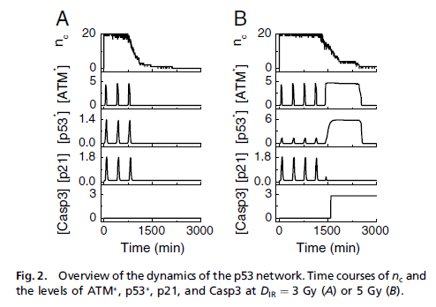
Normalized to t=0
Hours after irradiation
Xiao-Peng Zhang, Feng Liu, and Wei Wang, (2011) PNAS 108, 8990–8995
GEO data GDS479
Jen, K. Y. and V. G. Cheung (2003). Transcriptional response of lymphoblastoid cells to ionizing radiation. Genome Res 13(9): 2092-100.

Slide 15
NDPK expressed in NonMEtastatic cells, decreasing as cells become more cancerous

Slide 17
dNTP Supply
flux activation inhibition
ADP
nucleus
dATP
dCK
dA
DNA polymerase
GDP
dGTP
DNA
dCK
dG
CDP
dCTP
ATP
or
dATP
RNR
dCK
dC
mitochondria
UDP
dTTP
DCTD
cytosol
5NT
cytosol
TS
dA
dAMP
dATP
dUDP
dUMP
TK1
dGK
dT
dG
dGMP
dGTP
dUTP
dUTPase
dU
dN
dC
dCMP
dCTP
TK2
dT
dTMP
dTTP
NT2
dN

