Slide 1
Mathematical Models of dNTP Supply
Tom Radivoyevitch, PhD
Assistant Professor
Epidemiology and Biostatistics
CCCC Developmental Therapeutics Program

Slide 2

Single-Loop Temperature Control
5
10
0
Temperature demanded
controller
process
K_{p}
setpoint
+
water
temperature
∫
K_{i}
Σ
hot plate
Temperature supplied
-
process output = controller input; process input = controller output (= control effort)

Slide 3
Two-Inputs Two-Outputs
process
PI
Setpoint
+
+
Setpoint
PI
T
turbine
gas flow
turbine
T
recirc
air/o₂
stack
θ
-
PI
Setpoint
+
-
fuel
PI
Setpoint
+

Slide 4
Ultimate Goal
Better understanding => better control
Conceptual models help trial designs today
Computer models train pilots and autopilots
Safer flying airplanes with autopilots
Individualized, feedback-based therapies

Slide 5
dNTP Supply
flux activation
inhibition
ADP
nucleus
dATP
dCK
dA
DNA polymerase
GDP
dGTP
DNA
dCK
dG
CDP
dCTP
ATP
or
dATP
RNR
dCK
dC
mitochondria
UDP
dTTP
DCTD
cytosol
5NT
cytosol
TS
dA
dAMP
dATP
dUDP
dUMP
TK1
dGK
dT
dG
dGMP
dGTP
dUTP
dUTPase
dU
dN
dC
dCMP
dCTP
TK2
dT
dTMP
dTTP
NT2
dN
Many anticancer agents target or traverse this system.

Slide 6
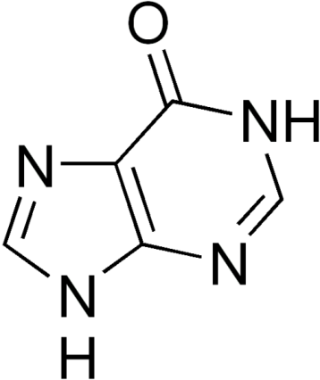
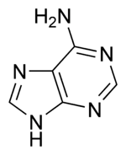
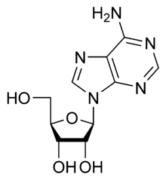
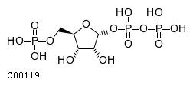
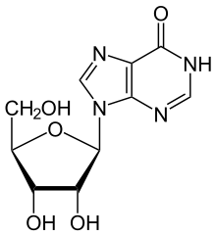
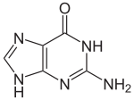
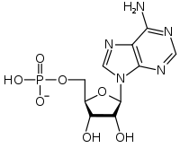
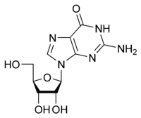
Purines
hypoxanthine
adenine
adenosine
Inosine, should be hypoxanthosine
guanine
Adenosine mono-
phosphate
guanosine

Slide 7
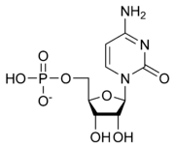
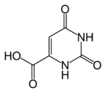
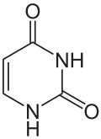
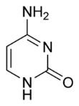
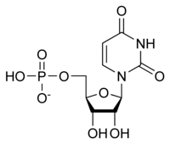
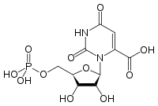
Pyrimidines
orotate
uracil
cytosine
Cytidine monophosphate
UDP→UTP→CTP→CDP
Orotidine 5'-monophosphate
Uridine monophosphate
dUDP dCDP

Slide 8
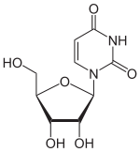
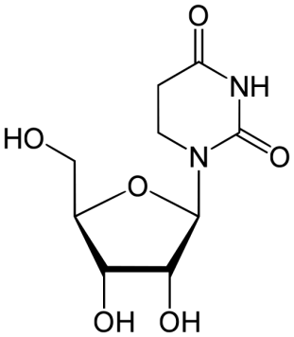
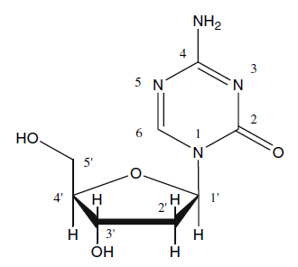
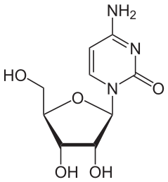
Pyrimidine Analogs
uridine
3,4,5,6-tetrahydrouridine
= dihydrouridine
cytidine
2’-deoxy-5-azacytidine
DAC

Slide 9
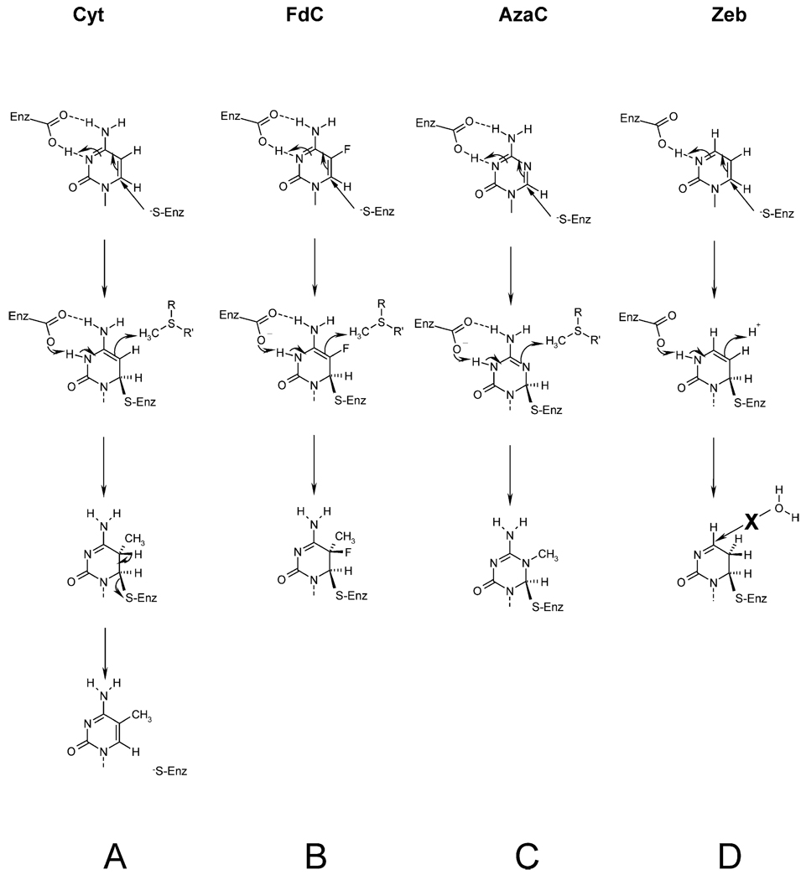
Inhibition of DNA-MT
J Mol Biol. 2002 Aug 23;321(4):591-9.
Zebularine: a novel DNA methylation inhibitor that forms a covalent complex with DNA methyltransferases.
Zhou L, Cheng X, Connolly BA, Dickman MJ, Hurd PJ, Hornby DP.
Department of Biochemistry, Emory University

Slide 10
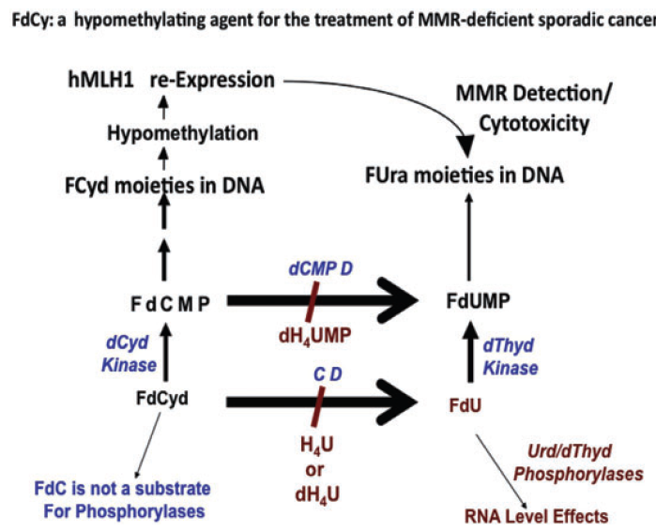
FdC

Slide 11
dNTP Supply
flux activation
inhibition
ADP
nucleus
dATP
dCK
dA
DNA polymerase
GDP
dGTP
DNA
dCK
dG
CDP
dCTP
ATP
or
dATP
RNR
dCK
dC
mitochondria
UDP
dTTP
DCTD
cytosol
5NT
cytosol
TS
dA
dAMP
dATP
dUDP
dUMP
TK1
dGK
dT
dG
dGMP
dGTP
dUTP
dUTPase
dU
dN
dC
dCMP
dCTP
TK2
dT
dTMP
dTTP
NT2
dN
Many anticancer agents target or traverse this system.

Slide 12
Ribonucleotide Reductase
ATP activates at hexamerization site??
dATP inhibits at activity site, ATP activates at activity site?
R1
R1
R1
R1
R1
R1
R1
R1
R1
ATP, dATP, dTTP, dGTP bind to selectivity site
UDP, CDP, GDP, ADP bind to catalytic site
R1
R1
R2
R2
R1
R1
R2
R2
R1
R1
R1
R1
R2
R2
5 catalytic site states x 5 s-site states x 3 a-site states x 2 h-site states = 150 states
(150)⁶ different hexamer complexes => 2^(150)⁶ models
2^(150)⁶ = ~1 followed by a trillion zeros
1 trillion complexes => 1 trillion (1 followed by only 12 zeros) 1-parameter models
RNR is Combinatorially Complex

Slide 13
Enzyme Modeling Overview
Model enzymes as quasi-equilibria (e.g. E ES)
Combinatorially Complex Equilibria:
    few reactants => many possible complexes
R package: Combinatorially Complex Equilibrium Model Selection (ccems) implements methods for activity and mass data
  Hypotheses: complete K = ∞ ⬄ [Complex] = 0 vs binary K₁ = K₂
Generate a set of possible models, fit them, and select the best
Model Selection: Akaike Information Criterion (AIC)
  AIC decreases with P and then increases
  Billions of models, but only thousands near AIC upturn
Generate 1P, 2P, 3P model space chunks sequentially
Use structures to constrain complexity and simplicity of models

Slide 14
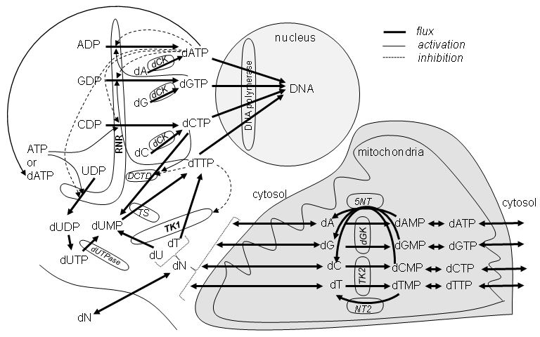
R Packages
Combinatorially Complex Equilibrium Model Selection (ccems, CRAN 2009)
Systems Biology Markup Language interface to R (SBMLR, BIOC 2004)
R1
R1
Model networks of enzymes
Model enzymes
R1
R1
R1
R1
R1
R1
R1
R1
R1
R1
R1
R2
R2
R2
R2
R1
R1
R1
R1
R2
R2
Go to SBMLR dNTP supply demo

Slide 15
MMR⁻ Treatment Hypothesis
IUdR
dNTP demand is either
Damage Driven
or
S-phase Driven
Salvage
dNTPs + Analogs
DNA + Drug-DNA
De novo
DNA repair

Slide 16
Indirect Approach pro-B Cell Childhood ALL
T: TEL-AML1 with HR
t : TEL-AML1 with CCR
t : other outcome
B: BCR-ABL with CCR
b: BCR-ABL with HR
b: censored, missing, or other outcome
Ross et al: Blood 2003, 102:2951-2959
Yeoh et al: Cancer Cell 2002, 1:133-143
Radivoyevitch et al., BMC Cancer 6, 104 (2006)

Slide 17
Folate Cycle (dTTP Supply)
Morrison PF, Allegra CJ: Folate cycle kinetics in human breast cancer cells. JBiolChem 1989, 264:10552-10566.
NADP⁺
NADPH
DHFR
Hcys
Met
10
MTR
4
THF
7
FAICAR
DHF
5
6
HCOOH
12
FDS
ATP
ATIC
11
2R
2
ATIC
Ser
FTS
CHODHF
HCHO
ADP
SHMT
Gly
AICAR
13
CH₃THF
FGAR
1R
1
GART
NADP⁺
NADPH
GAR
NADP⁺
NADPH
MTHFD
CHOTHF
3
MTHFR
8
9
CH₂THF
TS
dUMP
dTMP

Slide 18
p53⁻ Treatment Hypothesis
Residual DSBs at 24 hours post IR kill cells
dNTP supply inhibition retards DSB repair
p53⁻ cells are slower at DSB repair than wt
Best dNTP supply inhibition timing post IR is just after p53⁺ cells complete DSB repair
Questions: Prolonged RNR↓ => plasma [dN]↓? Compensation by RNR overexpression? Is dCK expression also increased?
-
+
24 h

Slide 19
Conclusions
For systems biology to succeed:
  move biological research toward systems which are best understood
  specialize modelers to become experts in biological literatures (e.g. dNTP Supply)
Systems biology is not a service

Slide 20
Acknowledgements
Case Comprehensive Cancer Center
NIH (K25 CA104791)
Charles Kunos (Case Western)
John Pink (Case Western)
Yogen Saunthararajah (Cleveland Clinic)
Yun Yen (City of Hope)
Run SBMLR code for dC increase and HU

Slide 21
Michaelis-Menten Model
E + S ES
but
so
Key perspective
RNR: no NDP and no R2 dimer => k_{cat} of complex is zero,
else different R1-R2-NDP complexes can have different k_{cat} values.

Slide 23
Free Concentrations Versus Totals
[S] vs. [S_{T}]
Substitute this in here to get a quadratic in [S] whose
solution is
Bigger systems of higher polynomials cannot be solved algebraically => use ODEs (above)
(3)
R=R1 r=R2₂
G=GDP t=dTTP
solid line = Eqs. (1-2)
dotted = Eq. (3)
Data from Scott, C. P., Kashlan, O. B., Lear, J. D., and Cooperman, B. S. (2001) Biochemistry 40(6), 1651-166

Slide 24
Enzyme, Substrate and Inhibitor
E ES
EI ESI
E ES
EI ESI
E ES
EI ESI
Competitive inhibition
E
EI ESI
E
EI ESI
E ES
EI
noncompetitive inhibition
Example of K=K’ Model
=
E | ES
EI | ESI
uncompetitive inhibition if k_{cat_ESI}=0
=
=
E ES
ESI
E ES
ESI
E
EI
E
ESI
E ES
=
E

Slide 25
Why Systems Biology
Model components: (Deterministic = signal) + (Stochastic = noise)
Statistics
Engineering
Emphasis is on the stochastic component of the model.
Is there something in the black box or are the input wires disconnected from the output wires such that only thermal noise is being measured?
Do we have enough data?
Emphasis is on the deterministic component of the model
We already know what is in the box, since we built it. The goal is to understand it well enough to be able to control it.
Predict the best multi-agent drug dose time course schedules
Increasing amounts of data/knowledge

